Slide 1
Do Transformers have Spectral Bias?
Application to low-level vision
Yilin Liu, Shengze Wang, Yunkui Pang

Slide 2
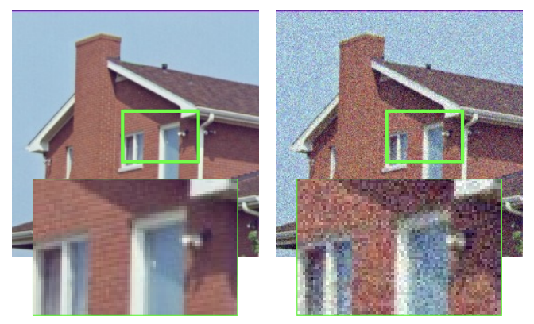
Background: Low-level Vision Tasks
Inverse problems: denoising, super-resolution, impainting, detail enhancement, etc.
y = Ax + e
Forward Problem
Observed
(corrupted)
Restored Clean
Noise
A: Forward model
Restored
Corrupted
Different tasks differ in forward model, i.e., A
x
y
Inverse Problem
Notes:
These are all inverse problems where we wanna recover the corrupted images to the high-quality ones. Conversely, there is forward problem which goes the other way around.

Slide 3
Objective: Denoising
This is the “simplest” inverse problem
y = x + e
Forward Problem
Observed
(noisy)
Denoised
(clean)
Noise
Denoised
Noisy Input
x
y
Inverse Problem

Slide 4
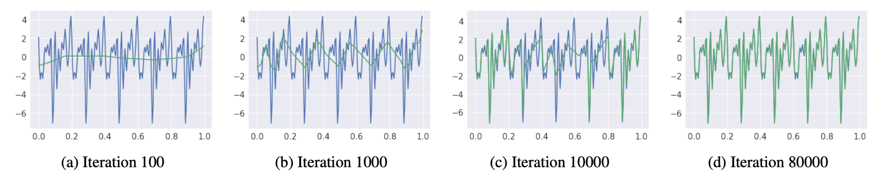
What is spectral bias?
An intriguing bias inherent in CNNs (F-principle):
When fitting a signal, the network first learns low frequencies, and then high frequencies.
Blue: target function
Green: learned function
Notes:
The target function is a superposition of sinusoids of frequencies (k = 5~50). Amplitudes are equal and phases are randomly sampled.

Slide 5
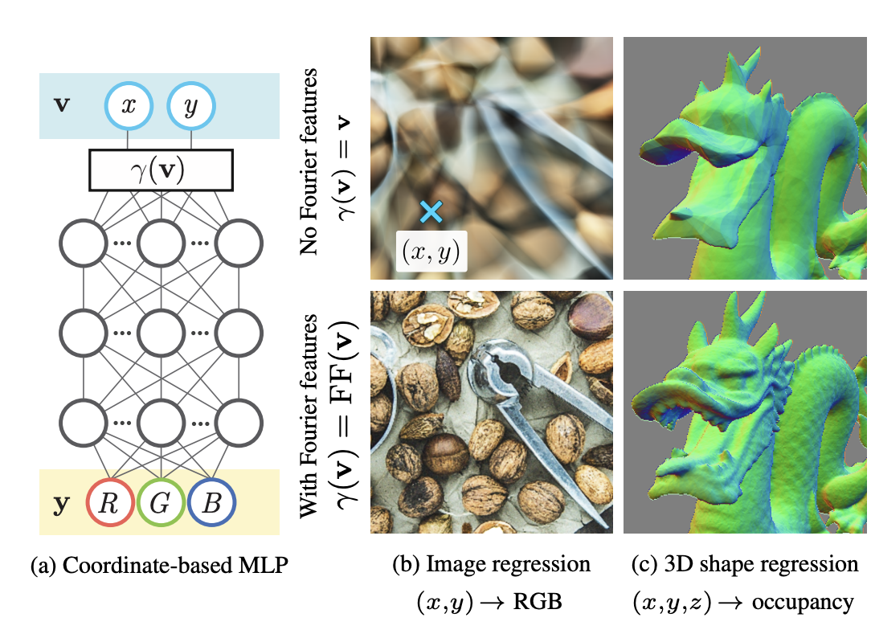
Spectral Bias In Reconstruction
“NeRF” (Tancik 2020, Mildenhall 2020):
MLP fails to learn high frequencies both in theory and practice because of the spectral bias
Need Positional Encoding (e.g. Fourier Features) to learn details

Slide 6
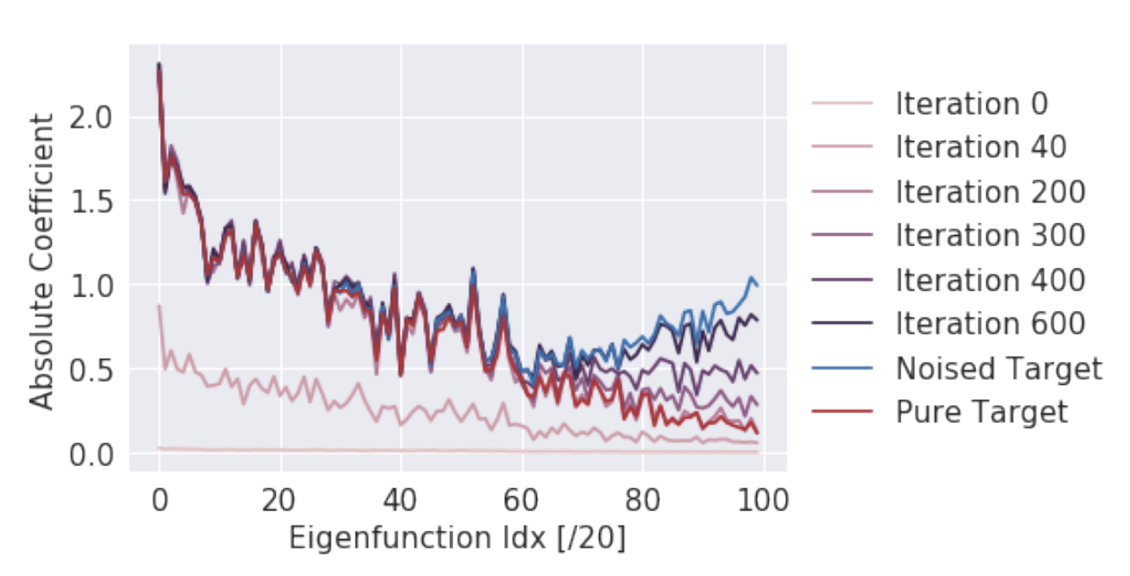
Spectral Bias In Denoising
But can we filter out high-freq noise with this bias? Deep image prior (CVPR 2018)
Right balance

Slide 7
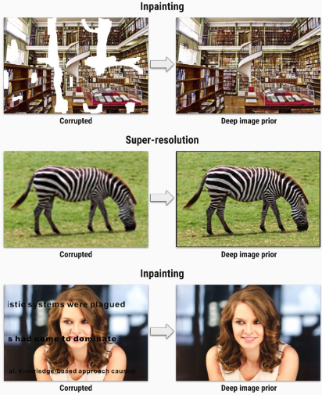
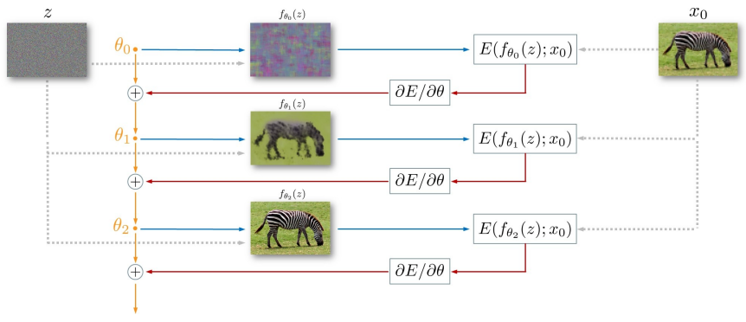
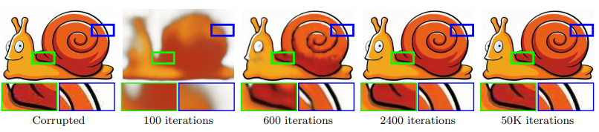
Deep Image Prior (CVPR 2018)
Self-supervised CNN using spectral bias for denoising, super-res, inpainting, etc.

Slide 8
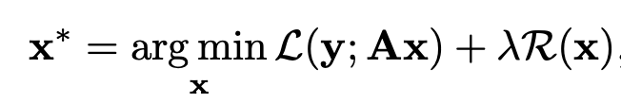
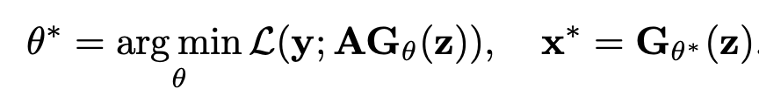
Loss
General (A: forward model, R: explicit image regularizer)
DIP (A: forward model, z: random noise vector, G: network, acts as an implicit regularizer)

Slide 9
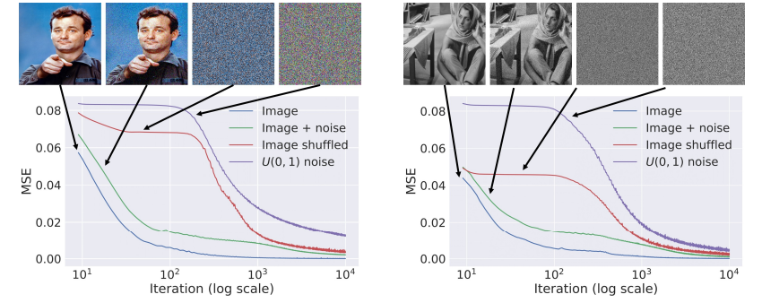
Deep Image Prior (CVPR 2018)
Insight 1: Easier to generate natural images than noise
clean
w/ noise
rand. perm.
pure noise
clean
w/ noise
rand. perm.
pure noise

Slide 10
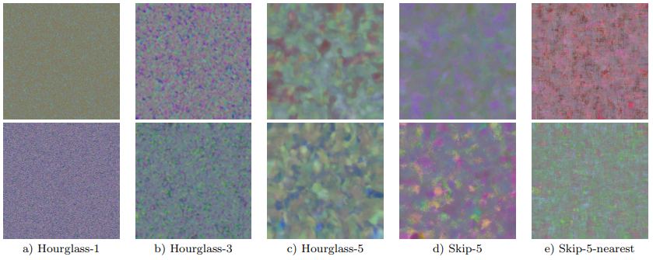
Deep Image Prior (CVPR 2018)
Insight 2: Depth -> global structure Skip connections -> local detail

Slide 11
Do Transformers have spectral bias too?
Yes
No
self-supervised denoising like DIP
supervised super-resolution tasks

Slide 12
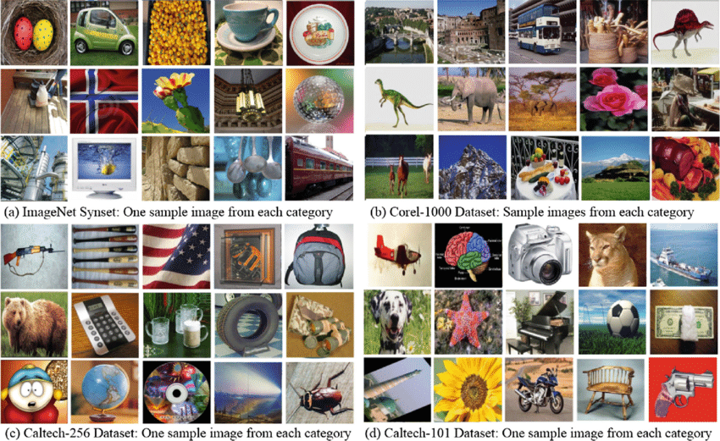
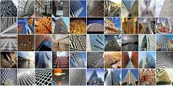
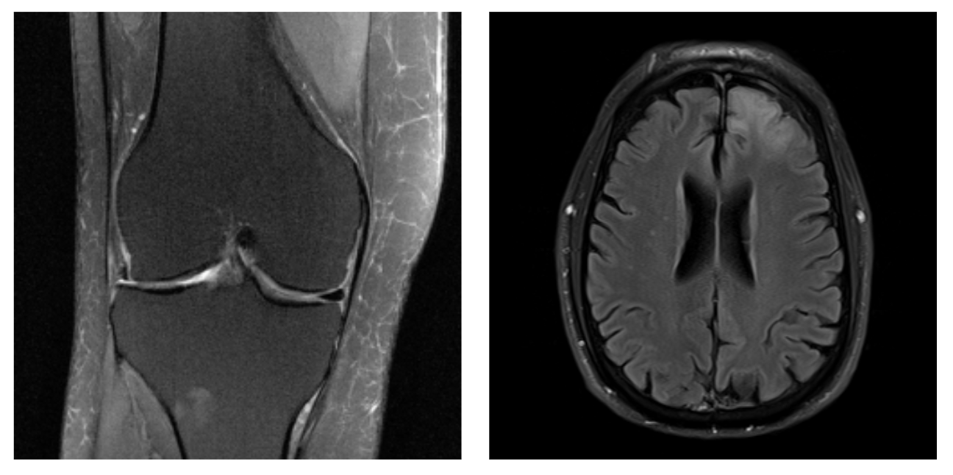
Dataset
ImageNet
Average resolution 469x387
1.2M images
DIV2K
2048x1080 resolution
1K images
FastMRI - (medical images)
4X and 8X undersampling
1.5K Knee/Brain MRIs

Slide 13
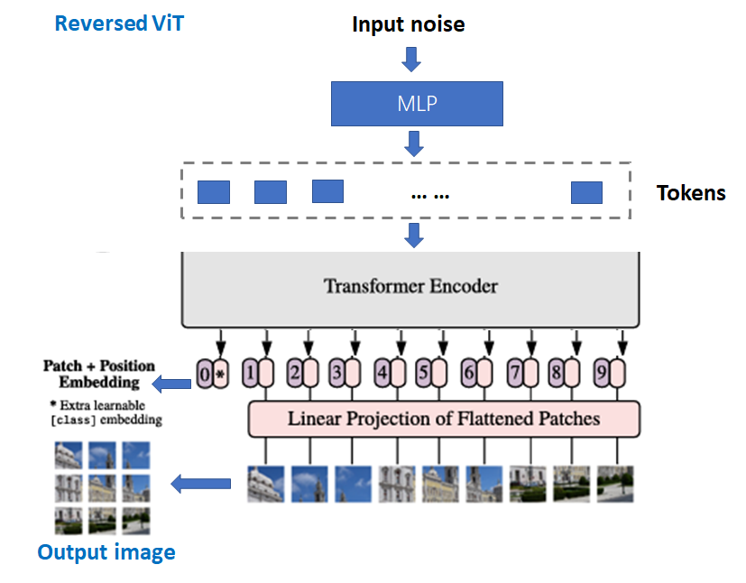
Experiments
Model: Decoder of ViT (“Dec-ViT”)
Pilot experiment:
Test the model in DIP-like settings to see if the training curve exhibits similar pattern as CNNs
Procedures:
For each image, randomly initialize the Transformer.
Few shot update parameters of the Transformer.
Monitor the training/PSNR/SSIM curves
If hypothesis is TRUE
Mathematical analysis.
If hypothesis is FALSE or not significant
Borrow concepts from CNN (like Swin Transformer)
Which structure of CNN causes bias towards low frequencies?

Slide 14
Architecture - Full
Encoder: ViT
Patch Size= 64x64 / 16x16
Attn Layers: width=512, depth=6, heads=8
Decoder: GPT3-like Transformer
Seq Length = # patches
Attn Layers: width=512, depth=6, heads=8
10k iterations

Slide 15
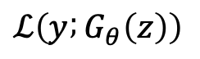
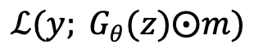
Loss
DIP (A: forward model, z: random noise vector, G: network, acts as an implicit regularizer)
Denoising
Inpainting (m: mask)

Slide 16
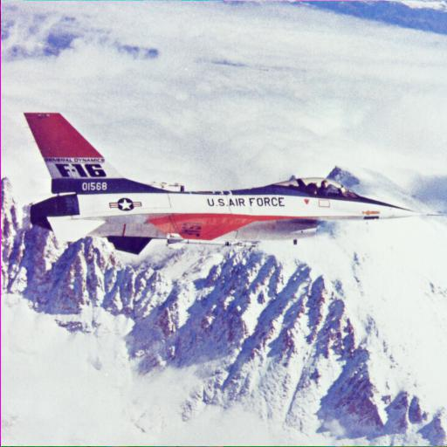
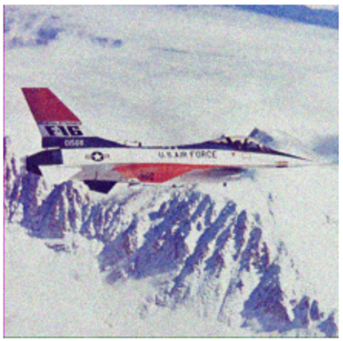
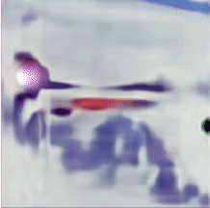
Denoising Experiment –– CNN
Clean Noisy Training Process

Slide 17

Denoising Experiment –– Transformer
Clean Noisy Training Process

Slide 18

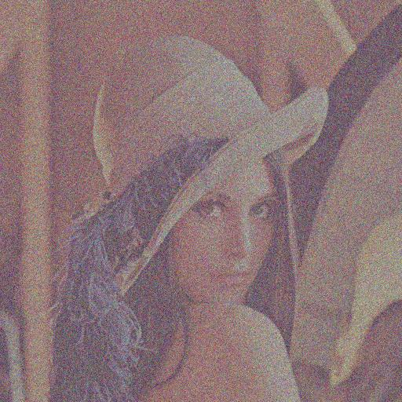

Denoising Experiment –– Transformer (More)
Clean
Corrupted
Training Process

Slide 19
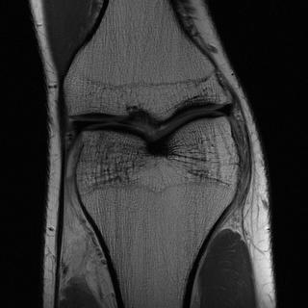


MRI Denoising Experiment –– Transformer (More)
Clean
Noisy
Training Process

Slide 20
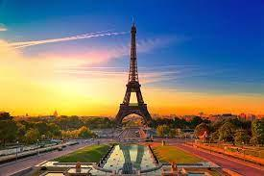


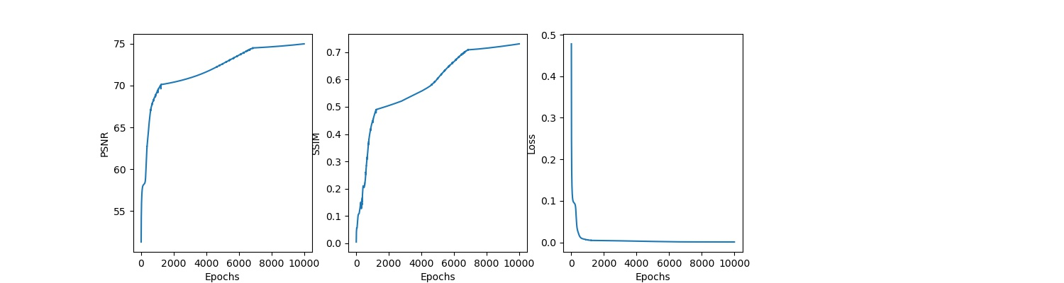
Denoising Experiment –– Transformer (More)
Clean
Corrupted
Training Process

Slide 21
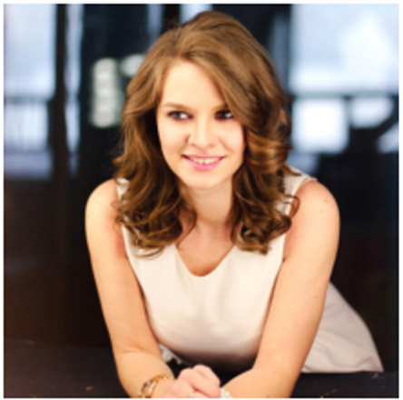

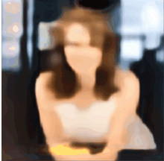
Inpainting Experiment — CNN
Clean
Corrupted
Training Process

Slide 22
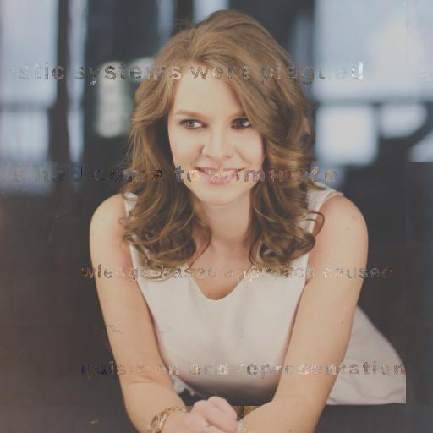
Inpainting Experiment — Transformer
Clean
Corrupted
Training Process

Slide 23
Observations
Denoising: both CNN and transformer overfit to the noisy target; transformers overfit too soon!
Inpainting: over-fitting not observable in CNN
Hypothesis: due to the mask in loss function: y: groundtruth G_{Θ}(z): reconstructed image from noise z m: mask

Slide 24
Current Issues & Solutions
Fails to denoise, fits the noise too early
Infers random noise during inpainting
Checkerboard artifacts (sometimes)
Corresponding Solutions:
Sparsify the transformer → to represent the image with fewer weights, may help limit the capability of fitting noise.
Add bottlenecks → transformer, to enable high-level understanding (e.g., semantic information)
Change the way how current model takes the noise inputs; divert to a generator-like transformer, where the noise input is gradually upsampled via up-sampling layers

Slide 25
Q & A

Slide 26
Thank You!
Yilin Liu, Shengze Wang, Yunkui Pang

